Slide 1



01CE0723 - DATA WAREHOUSING & DATA MINING
Unit - 1
Data warehousing
Dr. Ruchi Patel
Associate Professor
Computer Engineering Department

Slide 2


Outline
Introduction to Data Warehouse
Data warehouse vs Operational DBMS
Comparison of OLAP with OLTP
Multidimensional data model: Data cubes
Conceptual Modelling of Data warehouse: schemas
Multidimensional Data
OLAP operations
Data Warehouse architecture
OLAP Server Architecture: ROLAP, MOLAP

Slide 3
1.1 Introduction to Data Warehouse
Defined in many different ways, but not rigorously.
A decision support database that is maintained separately from the organization’s operational database.
Support information processing by providing a solid platform of consolidated, historical data
for analysis.
“A data warehouse is a subject-oriented, integrated, time-variant, and nonvolatile collection of data in support of management’s decision-making process.”—W. H. Inmon
Data warehousing:
The process of constructing and using data warehouses

Slide 4
Data Warehouse—Subject-Oriented
Organized around major subjects, such as customer, product, sales.
Focusing on the modeling and analysis of data for decision makers, not on daily operations or transaction processing.
Provide a simple and concise view around particular subject issues by excluding data that are not useful in the decision support process.

Slide 5
Data Warehouse—Integrated
Constructed by integrating multiple, heterogeneous data sources
relational databases, flat files, on-line transaction records
Data cleaning and data integration techniques are applied.
Ensure consistency in naming conventions, encoding structures, attribute measures, etc. among different data sources
E.g., Hotel price: currency, tax, breakfast covered, etc.
When data is moved to the warehouse, it is converted.

Slide 6
Data Warehouse—Time Variant
The time horizon for the data warehouse is significantly longer than that of operational
systems
Operational database: current value data.
Data warehouse data: provide information from a historical perspective (e.g., past 5-10 years).
Every key structure in the data warehouse:
Contains an element of time, explicitly or implicitly.
But the key of operational data may or may not contain “time element”.

Slide 7
Data Warehouse—Nonvolatile
A physically separate store of data transformed from the operational environment
Operational update of data does not occur in the data warehouse environment
Does not require transaction processing, recovery, and concurrency control mechanisms
Requires only two operations in data accessing:
initial loading of data and access of data.

Slide 8
1.2 Data Warehouse vs. Operational DBMS
OLTP (on-line transaction processing)
Major task of traditional relational DBMS
Day-to-day operations: purchasing, inventory, banking, manufacturing, payroll, registration, accounting, etc.
OLAP (on-line analytical processing)
Major task of data warehouse system
Data analysis and decision making
Distinct features (OLTP vs. OLAP):
User and system orientation: customer vs. market
Data contents: current, detailed vs. historical, consolidated
Database design: ER + application vs. star + subject
View: current, local vs. evolutionary, integrated
Access patterns: update vs. read-only but complex queries

Slide 9
1.3 OLTP vs. OLAP

Slide 10
1.4 From Tables and Spreadsheets to Data Cubes
A data warehouse is based on a multidimensional data model which views data in the form of a data cube.
A data cube, such as sales, allows data to be modeled and viewed in multiple dimensions
Dimension tables, such as item (item_name, brand, type), or time(day, week, month, quarter, year)
Fact table contains measures (such as dollars_sold) and keys to each of the related dimension tables
In data warehousing literature, an n-D base cube is called a base cuboid. The top most 0-D
cuboid, which holds the highest-level of summarization, is called the apex cuboid. The lattice
of cuboids forms a data cube.

Slide 11
Cube: A Lattice of Cuboids
all
0-D(apex) cuboid
time
item
location
supplier
1-D cuboids
time,location
item,location
location,supplier
2-D cuboids
time,supplier
item,supplier
time,location,supplier
3-D cuboids
time,item,supplier
item,location,supplier
4-D(base) cuboid

Slide 12
1.5 Conceptual Modeling of Data Warehouses
Modeling data warehouses: dimensions & measures
Star schema: A fact table in the middle connected to a set of dimension tables
Snowflake schema: A refinement of star schema where some dimensional hierarchy is normalized into a set of smaller dimension tables, forming a shape similar to snowflake
Fact constellations: Multiple fact tables share dimension tables, viewed as a collection of
stars, therefore called galaxy schema or fact constellation

Slide 13
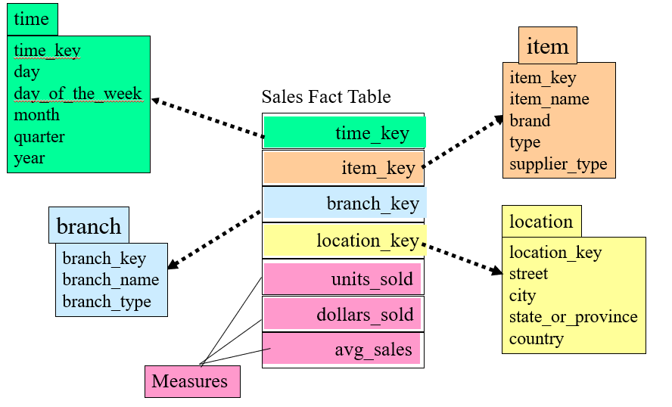
Example of Star Schema

Slide 14
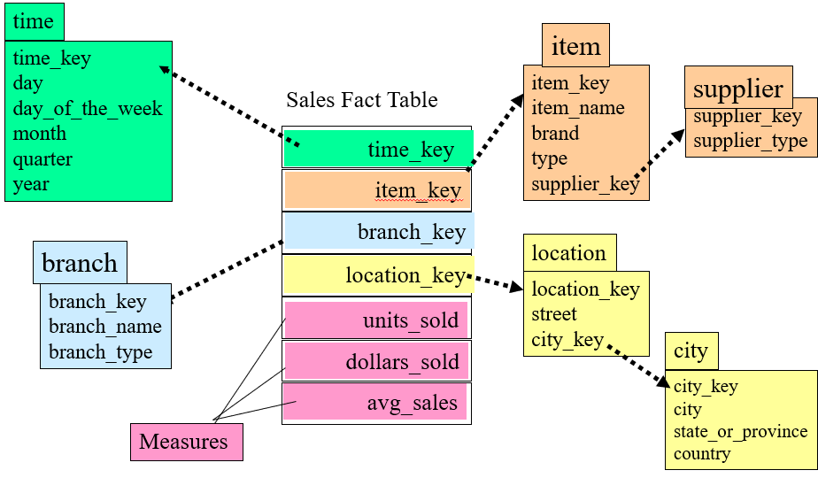
Example of Snowflake Schema

Slide 15
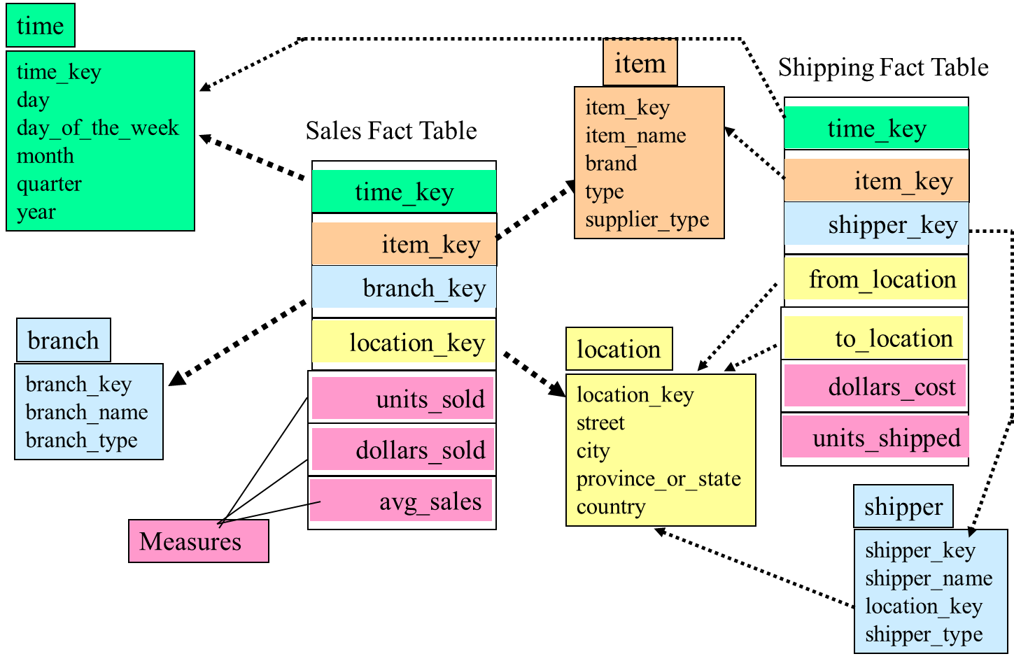
Example of Fact Constellation

Slide 16
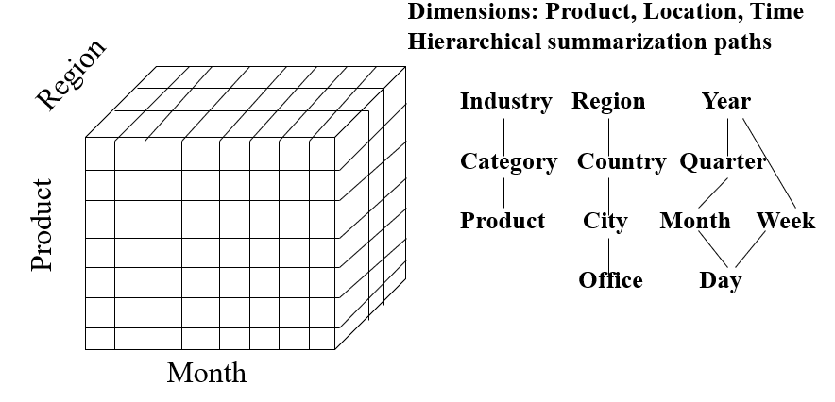
1.6 Multidimensional Data
Sales volume as a function of product, month, and region

Slide 17
A Sample Data Cube
Date
1Qtr
2Qtr
3Qtr
4Qtr
sum
Product
TV
PC
U.S.A
VCR
sum
Canada
Country
Mexico
sum
All, All, All

Slide 18
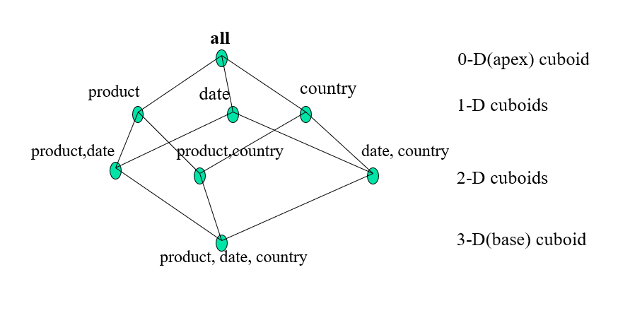
Cuboids Corresponding to the Cube

Slide 19
1.7 Typical OLAP Operations
Roll up (drill-up): summarize data
by climbing up hierarchy or by dimension reduction
Drill down (roll down): reverse of roll-up
from higher level summary to lower level summary or detailed data, or introducing new dimensions
Slice and dice: project and select
Pivot (rotate):
reorient the cube, visualization, 3D to series of 2D planes
Other operations
drill across: involving (across) more than one fact table
drill through: through the bottom level of the cube to its back-end relational tables (using SQL)

Slide 21
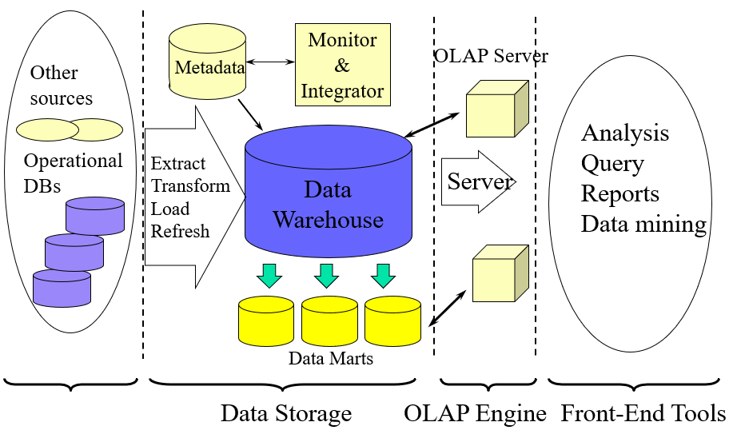
1.8 Data Warehouse: A Multi-Tiered Architecture

Slide 22
Three Data Warehouse Models
Enterprise warehouse
collects all of the information about subjects spanning the entire organization
Data Mart
a subset of corporate-wide data that is of value to a specific groups of users. Its scope is confined to specific, selected groups, such as marketing data mart
Independent vs. dependent (directly from warehouse) data mart
Virtual warehouse
A set of views over operational databases

Slide 23
Data Warehouse Back-End Tools and Utilities
Data extraction
get data from multiple, heterogeneous, and external sources
Data cleaning
detect errors in the data and rectify them when possible
Data transformation
convert data from legacy or host format to warehouse format
Load
sort, summarize, consolidate, compute views, check integrity, and build indicies and partitions
Refresh
propagate the updates from the data sources to the warehouse

Slide 24
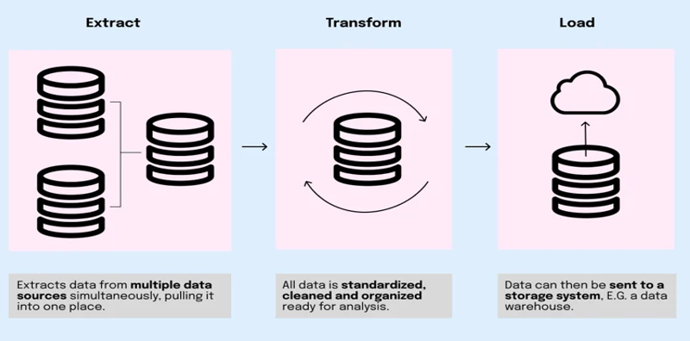
The ETL Process

Slide 25
1.9 OLAP Server Architectures
Relational OLAP (ROLAP)
Use relational or extended-relational DBMS to store and manage warehouse data and OLAP middle ware
Include optimization of DBMS backend, implementation of aggregation navigation logic, and additional tools and services
Greater scalability
Multidimensional OLAP (MOLAP)
Sparse array-based multidimensional storage engine
Fast indexing to pre-computed summarized data
Hybrid OLAP (HOLAP) (e.g., Microsoft SQLServer)
Flexibility, e.g., low level: relational, high-level: array
Specialized SQL servers (e.g., Redbricks)
Specialized support for SQL queries over star/snowflake schemas

Slide 26
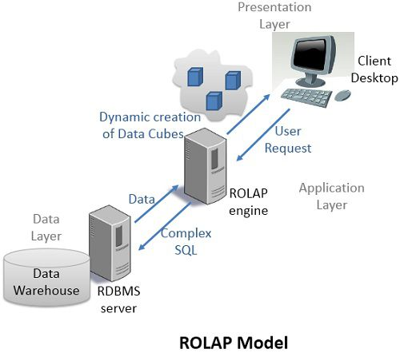
ROLAP
ROLAP is Relational Online Analytical Processing model, where the data is stored as in relational database i.e. rows and columns in the data warehouse.

Slide 27
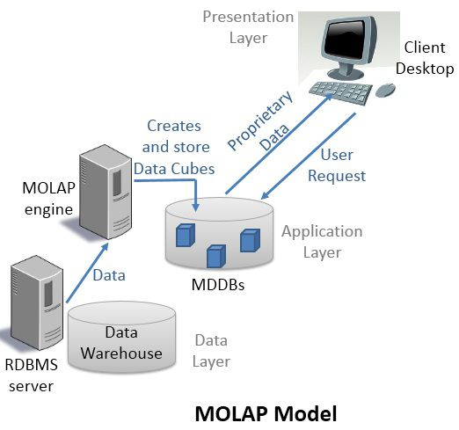
MOLAP
MOLAP is a Multidimensional Online Analytical Processing model. The data used for analysis is stored in specialized multidimensional databases (MDDBs).

Slide 28
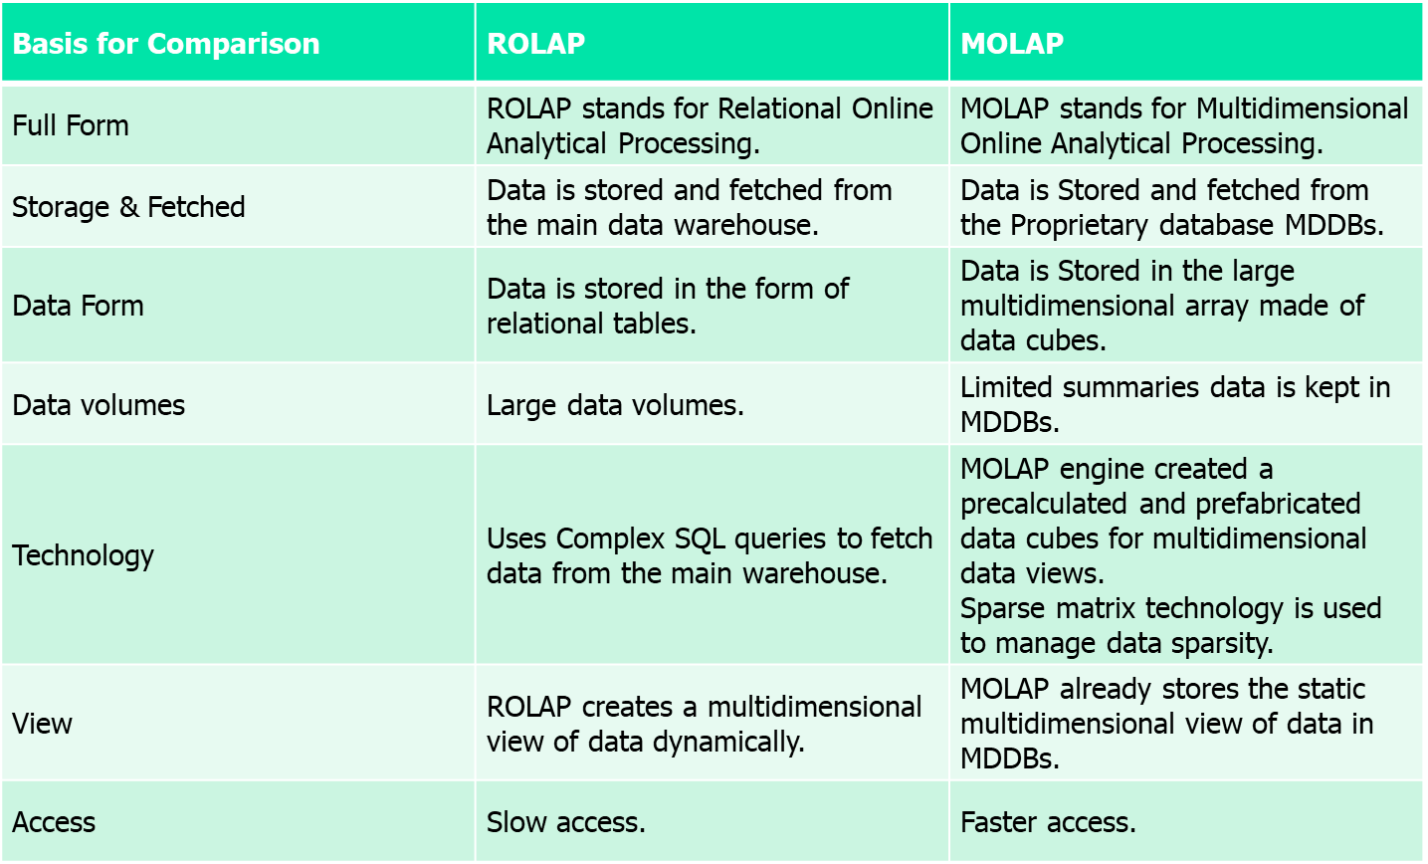
ROLAP vs. MOLAP

Slide 29
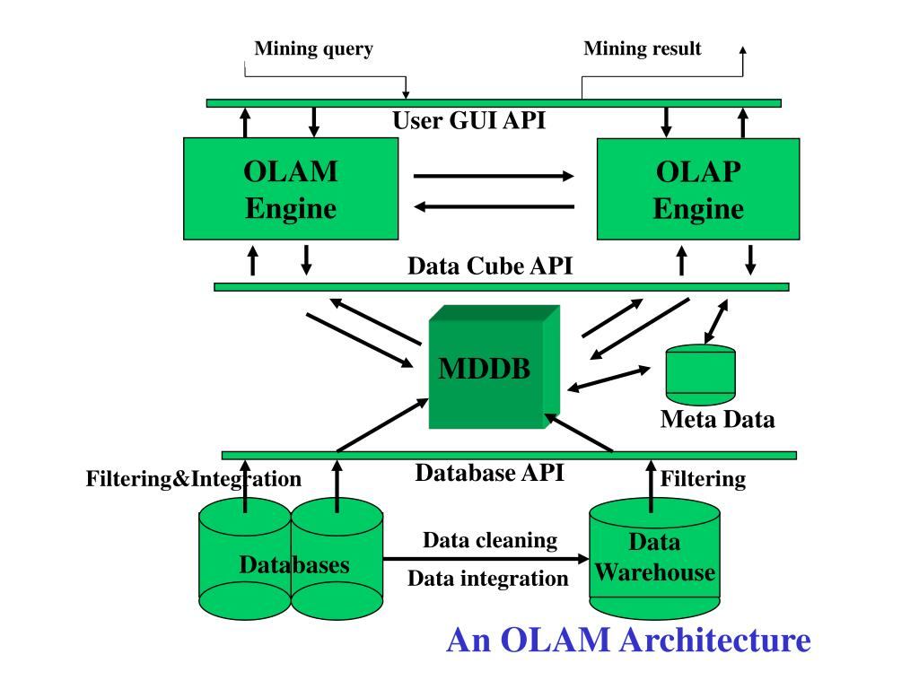
OLAM Architecture

Slide 30
References
http://www.faadooengineers.com/online-study/post/cse/datamining-and-data-ware-housing/107/on-line-analytical-processing-to-on-line-analytical-mining
https://galaktika-soft.com/blog/olap-vs-olam.html
https://www.tutorialspoint.com/data_mining/dm_evaluation.htm

Slide 31

Thank You

